Slide 1

CS244a: An Introduction to Computer Networks
Handout 3:
Foundations and Basic Concepts
Nick McKeown
Professor of Electrical Engineering
and Computer Science, Stanford University
nickm@stanford.edu
http://www.stanford.edu/~nickm
Winter 2006
CS244a Handout 3

Slide 2
Outline
A Detailed FTP Example
Layering
Packet Switching and Circuit Switching
Some terms
  Data rate, “Bandwidth” and “throughput”
  Propagation delay
  Packet, header, address
  Bandwidth-delay product, RTT
Winter 2006
CS244a Handout 3

Slide 3

Example: FTP over the Internet
Using TCP/IP and Ethernet
1
App
20
App
“A” Stanford
“B” (MIT)
OS
OS
2
3
4
19
18
17
Ethernet
Ethernet
5
14
R1
6
15
R5
8
11
7
16
9
R2
R3
12
10
13
R4
Winter 2006
CS244a Handout 3

Slide 4
In the sending host
Application-Programming Interface (API)
  Application requests TCP connection with “B”
Transmission Control Protocol (TCP)
  Creates TCP “Connection setup” packet
  TCP requests IP packet to be sent to “B”
TCP Packet
TCP
Data
TCP
Header
Type = Connection Setup
Empty
Winter 2006
CS244a Handout 3

Slide 5
In the sending host (2)
3. Internet Protocol (IP)
  Creates IP packet with correct addresses.
  IP requests packet to be sent to router.
TCP Packet
TCP
Data
TCP
Header
Encapsulation
IP
Data
IP
Header
Destination Address: IP “B”
Source Address: IP “A”
Protocol = TCP
IP Packet
Winter 2006
CS244a Handout 3

Slide 6
In the sending host (3)
4. Link (“MAC” or Ethernet) Protocol
  Creates MAC frame with Frame Check Sequence (FCS).
  Wait for Access to the line.
  MAC requests PHY to send each bit of the frame.
IP Packet
IP
Data
IP
Header
Encapsulation
Ethernet
FCS
Ethernet
Data
Ethernet
Header
Destination Address: MAC “R1”
Source Address: MAC “A”
Protocol = IP
Ethernet Packet
Winter 2006
CS244a Handout 3

Slide 7
In Router R1
5. Link (“MAC” or Ethernet) Protocol
  Accept MAC frame, check address and Frame Check Sequence (FCS).
  Pass data to IP Protocol.
IP Packet
IP
Data
IP
Header
Decapsulation
Ethernet
FCS
Ethernet
Data
Ethernet
Header
Destination Address: MAC “R1”
Source Address: MAC “A”
Protocol = IP
Ethernet Packet
Winter 2006
CS244a Handout 3

Slide 8
In Router R1
6. Internet Protocol (IP)
  Use IP destination address to decide where to send packet next (“next-hop routing”).
  Request Link Protocol to transmit packet.
IP
Data
IP
Header
Destination Address: IP “B”
Source Address: IP “A”
Protocol = TCP
IP Packet
Winter 2006
CS244a Handout 3

Slide 9
In Router R1
7. Link (“MAC” or Ethernet) Protocol
  Creates MAC frame with Frame Check Sequence (FCS).
  Wait for Access to the line.
  MAC requests PHY to send each bit of the frame.
IP Packet
IP
Data
IP
Header
Encapsulation
Ethernet
FCS
Ethernet
Data
Ethernet
Header
Destination Address: MAC “R2”
Source Address: MAC “R1”
Protocol = IP
Ethernet Packet
Winter 2006
CS244a Handout 3

Slide 10
In Router R5
16. Link (“MAC” or Ethernet) Protocol
  Creates MAC frame with Frame Check Sequence (FCS).
  Wait for Access to the line.
  MAC requests PHY to send each bit of the frame.
IP Packet
IP
Data
IP
Header
Encapsulation
Ethernet
FCS
Ethernet
Data
Ethernet
Header
Destination Address: MAC “B”
Source Address: MAC “R5”
Protocol = IP
Ethernet Packet
Winter 2006
CS244a Handout 3

Slide 11
In the receiving host
17. Link (“MAC” or Ethernet) Protocol
  Accept MAC frame, check address and Frame Check Sequence (FCS).
  Pass data to IP Protocol.
IP Packet
IP
Data
IP
Header
Decapsulation
Ethernet
FCS
Ethernet
Data
Ethernet
Header
Destination Address: MAC “B”
Source Address: MAC “R5”
Protocol = IP
Ethernet Packet
Winter 2006
CS244a Handout 3

Slide 12
In the receiving host (2)
18. Internet Protocol (IP)
  Verify IP address.
  Extract/decapsulate TCP packet from IP packet.
  Pass TCP packet to TCP Protocol.
TCP Packet
TCP
Data
TCP
Header
Decapsulation
IP
Data
IP
Header
Destination Address: IP “B”
Source Address: IP “A”
Protocol = TCP
IP Packet
Winter 2006
CS244a Handout 3

Slide 13
In the receiving host (3)
19. Transmission Control Protocol (TCP)
  Accepts TCP “Connection setup” packet
  Establishes connection by sending “Ack”.
20. Application-Programming Interface (API)
  Application receives request for TCP connection with “A”.
TCP Packet
TCP
Data
TCP
Header
Type = Connection Setup
Empty
Winter 2006
CS244a Handout 3

Slide 14
Outline
A Detailed FTP Example
Layering
Packet Switching and Circuit Switching
Some terms
  Data rate, “Bandwidth” and “throughput”
  Propagation delay
  Packet, header, address
  Bandwidth-delay product, RTT
Winter 2006
CS244a Handout 3

Slide 15
Layering: The OSI Model
layer-to-layer communication
Application
Application
7
7
Presentation
Presentation
6
6
Session
Session
5
5
Transport
Peer-layer communication
Transport
4
Router
Router
4
Network
Network
Network
Network
3
3
Link
Link
Link
Link
2
2
Physical
Physical
Physical
Physical
1
1
Winter 2006
CS244a Handout 3

Slide 16
Layering: Our FTP Example
Application
FTP
Application
Presentation
ASCII/Binary
Session
Transport
TCP
Transport
Network
Network
IP
Link
Link
Ethernet
Physical
The 7-layer OSI Model
The 4-layer Internet model
Winter 2006
CS244a Handout 3

Slide 17
Outline
A Detailed FTP Example
Layering
Packet Switching and Circuit Switching
Some terms
  Data rate, “Bandwidth” and “throughput”
  Propagation delay
  Packet, header, address
  Bandwidth-delay product, RTT
Winter 2006
CS244a Handout 3

Slide 18
Circuit Switching
A
B
Source
Destination
It’s the method used by the telephone network.
A call has three phases:
  Establish circuit from end-to-end (“dialing”),
  Communicate,
  Close circuit (“tear down”).
Originally, a circuit was an end-to-end physical wire.
Nowadays, a circuit is like a virtual private wire: each call has its own private, guaranteed data rate from end-to-end.
Winter 2006
CS244a Handout 3

Slide 19


Circuit Switching
Telephone Network
Each phone call is allocated 64kb/s. So, a 2.5Gb/s trunk line can carry about 39,000 calls.
Source
“Caller”
Destination
“Callee”
Central
Office
“C.O.”
Central
Office
“C.O.”
Trunk
Exchange
Winter 2006
CS244a Handout 3

Slide 20
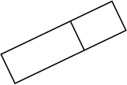
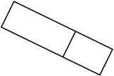




1
R2
1
2
2
1
2
1
A
R1
R3
B
2
R4
It’s the method used by the Internet.
Each packet is individually routed packet-by-packet, using the router’s local routing table.
The routers maintain no per-flow state.
Different packets may take different paths.
Several packets may arrive for the same output link at the same time, therefore a packet switch has buffers.
Winter 2006
CS244a Handout 3

Slide 21
Packet Switching
Simple router model
“4”
Link 1, ingress
Choose
Egress
Link 1, egress
Link 2
Link 2, ingress
Choose
Egress
Link 2, egress
R1
“4”
Link 1
Link 3
Link 3, ingress
Choose
Egress
Link 3, egress
Link 4
Link 4, ingress
Choose
Egress
Link 4, egress
Winter 2006
CS244a Handout 3

Slide 22
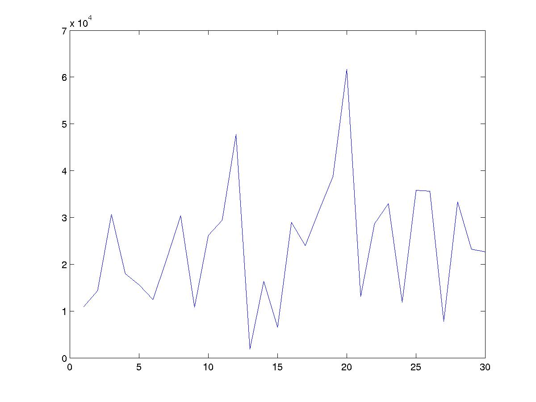
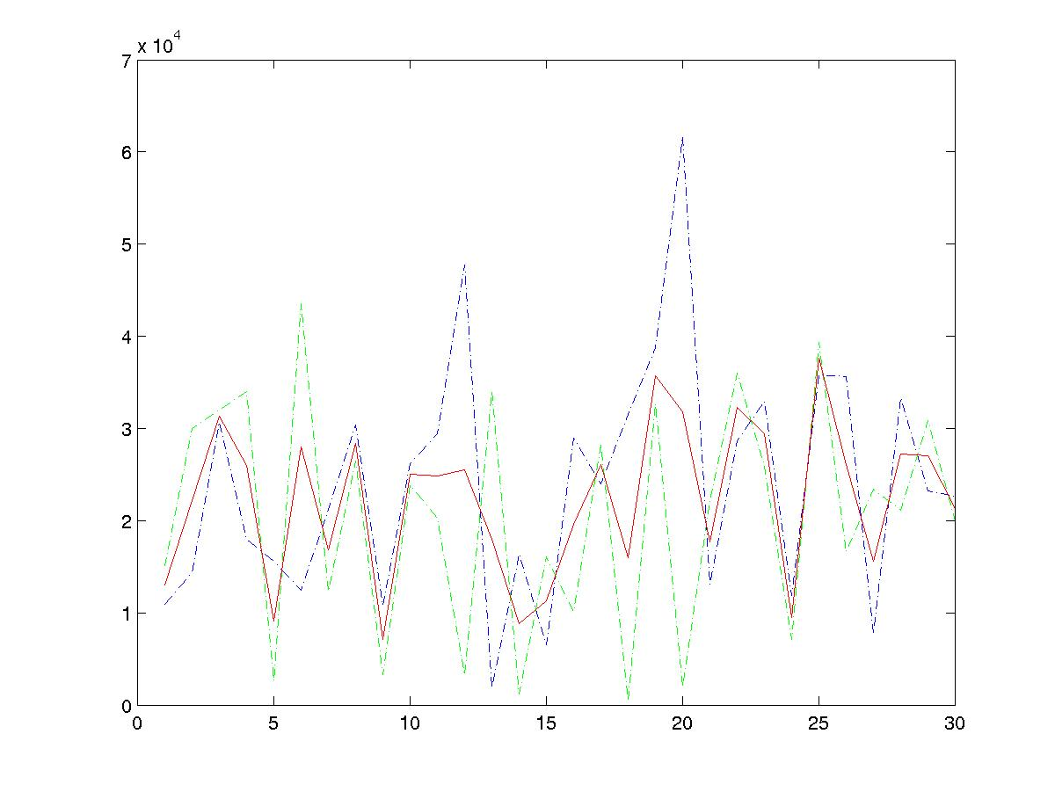
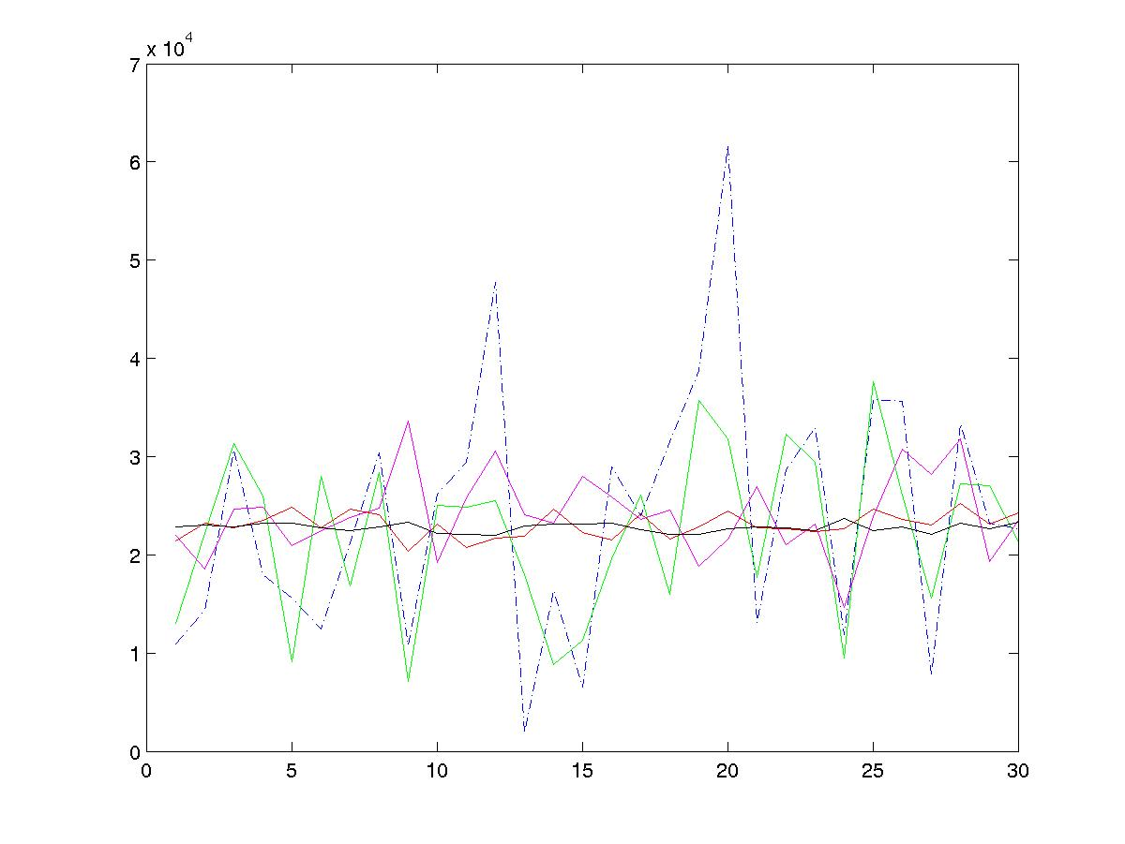
Statistical Multiplexing
Basic idea
One flow
Two flows
rate
rate
Average rate
time
Many flows
time
Network traffic is bursty.
i.e. the rate changes frequently.
Peaks from independent flows
generally occur at different times.
Conclusion: The more flows we have,
the smoother the traffic.
rate
Average rates of:
1, 2, 10, 100, 1000 flows.
time
Winter 2006
CS244a Handout 3

Slide 23
Packet Switching
Statistical Multiplexing
Packets for one output
Queue Length
X(t)
Dropped packets
Dropped packets
1
Data
Hdr
R
X(t)
B
2
Data
Hdr
R
Link rate, R
R
Packet buffer
N
Data
Hdr
Time
Because the buffer absorbs temporary bursts, the egress link need not operate at rate N.R.
But the buffer has finite size, B, so losses will occur.
Winter 2006
CS244a Handout 3

Slide 24
Statistical Multiplexing
Rate
A
C
A
C
time
Rate
B
C
B
C
time
Winter 2006
CS244a Handout 3
Notes:
Statistical multiplexing
Important if traffic is bursty
Less expensive
Contention requires buffering
Variable delay => no QoS guarantees

Slide 25
Statistical Multiplexing Gain
A+B
Rate
2C
R < 2C
A
R
B
time
Statistical multiplexing gain = 2C/R
Other definitions of SMG: The ratio of rates that give rise to a particular queue occupancy, or particular loss probability.
Winter 2006
CS244a Handout 3
Notes:
Statistical multiplexing
Important if traffic is bursty
Less expensive
Contention requires buffering
Variable delay => no QoS guarantees

Slide 26
Why does the Internet use packet switching?
Efficient use of expensive links:
  The links are assumed to be expensive and scarce.
  Packet switching allows many, bursty flows to share the same link efficiently.
  “Circuit switching is rarely used for data networks, ... because of very inefficient use of the links” - Gallager
Resilience to failure of links & routers:
  ”For high reliability, ... [the Internet] was to be a datagram subnet, so if some lines and [routers] were destroyed, messages could be ... rerouted” - Tanenbaum
Winter 2006
CS244a Handout 3
Notes:
Breaking message into packets allows parallel transmission across all links, reducing network latency.
In summary the benefits that of packet switched networks can be summarized as follows:
They use the bandwidth efficiently, meaning that a trunk link uses less resources than the sum of its tributaries, as they multiplex and conserve bandwidth
They have little state in the intermediate nodes
They are robust, some claim that they were designed to withstand a nuclear attack
They do not have a central authority from whom we need permission to run experiments

Slide 27
Some Definitions
Packet length, P, is the length of a packet in bits.
Link length, L, is the length of a link in meters.
Data rate, R, is the rate at which bits can be sent, in bits/second, or b/s.¹
Propagation delay, PROP, is the time for one bit to travel along a link of length, L.
PROP = L/c.
Transmission time, TRANSP, is the time to transmit a packet of length P.
TRANSP = P/R.
Latency is the time from when the first bit begins transmission, until the last bit has been received. On a link:
Latency = PROP + TRANSP.
1. Note that a kilobit/second, kb/s, is 1000 bits/second, not 1024 bits/second.
Winter 2006
CS244a Handout 3

Slide 28
A
B
R2
R1
R3
R4
A
???
R1
???
???
???
R2
???
???
R3
???
B
???
Winter 2006
CS244a Handout 3

Slide 29


Packet Switching
Why not send the entire message in one packet?
P/R
P/R
A
A
R1
R1
R2
R2
R3
R3
B
B
Trễ từ điểm đầu đến điểm cuối của bản tin
Trễ từ điểm đầu đến điểm cuối của 4 gói nhỏ
Breaking message into packets allows parallel transmission across all links, reducing end to end latency. It also prevents a link from being “hogged” for a long time by one message.
Winter 2006
CS244a Handout 3

Slide 30
Packet Switching
Queueing Delay
Because the egress link is not necessarily free when a packet arrives, it may be queued in a buffer. If the network is busy, packets might have to wait a long time.
Host A
TRANSP1
Q2
R1
TRANSP2
How can we determine the queueing delay?
PROP1
TRANSP3
R2
PROP2
TRANSP4
R3
PROP3
Host B
PROP4
Winter 2006
CS244a Handout 3

Slide 31
Queues and Queueing Delay
To understand the performance of a packet switched network, we can think of it as a series of queues interconnected by links.
For given link rates and lengths, the only variable is the queueing delay.
If we can understand the queueing delay, we can understand how the network performs.
Winter 2006
CS244a Handout 3

Slide 32
Queues and Queueing Delay
Cross traffic causes congestion and variable queueing delay.
Winter 2006
CS244a Handout 3

Slide 33
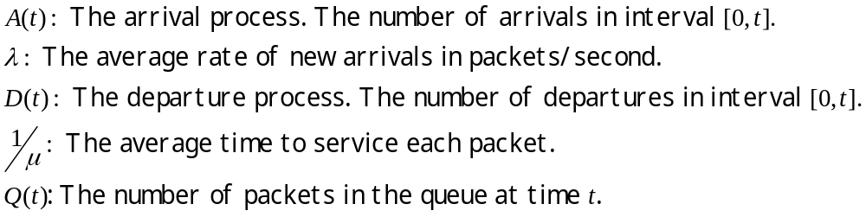
A router queue
Model of FIFO router queue
A(t), λ
μ
D(t)
Q(t)
Winter 2006
CS244a Handout 3

Slide 34
A simple deterministic model
Model of FIFO router queue
A(t), λ
μ
D(t)
Q(t)
Properties of A(t), D(t):
A(t), D(t) are non-decreasing
A(t) >= D(t)
Winter 2006
CS244a Handout 3

Slide 35
A simple deterministic model bytes or “fluid”
Cumulative number of bits that arrived up until time t.
A(t)
A(t)
Cumulative
number of bits
D(t)
Q(t)
μ
Service
process
μ
time
D(t)
Properties of A(t), D(t):
A(t), D(t) are non-decreasing
A(t) >= D(t)
Cumulative number of departed bits up until time t.
Winter 2006
CS244a Handout 3

Slide 36
Simple deterministic model
Cumulative
number of bits
d(t)
A(t)
Q(t)
D(t)
time
Queue occupancy: Q(t) = A(t) - D(t).
Queueing delay, d(t), is the time spent in the queue by a bit that arrived at time t, and if the queue is served first-come-first-served (FCFS or FIFO)
Winter 2006
CS244a Handout 3

Slide 37
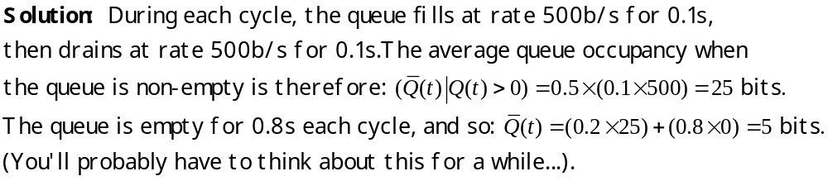
Example
Cumulative
number of bits
Q(t)
Example: Every second, a train of 100 bits arrive
at rate 1000b/s. The maximum departure rate is 500b/s.
What is the average queue occupancy?
d(t)
A(t)
100
D(t)
0.1s
0.2s
1.0s
time
Winter 2006
CS244a Handout 3

Slide 38
Queues with Random Arrival Processes
Usually, arrival processes are complicated, so we often model them as random processes.
The study of queues with random arrival processes is called Queueing Theory.
Queues with random arrival processes have some interesting properties. We’ll consider some here.
Winter 2006
CS244a Handout 3

Slide 39
Properties of queues
Time evolution of queues.
Examples
  Burstiness increases delay
  Determinism minimizes delay
Little’s Result.
The M/M/1 queue.
Winter 2006
CS244a Handout 3

Slide 40

Time evolution of a queue
Packets
Model of FIFO router queue
A(t), λ
μ
D(t)
Q(t)
Packet
Arrivals:
Departures:
time
Q(t)
Winter 2006
CS244a Handout 3

Slide 41
Burstiness increases delay
Example 1: Periodic arrivals
  1 packet arrives every 1 second
  1 packet can depart every 1 second
  Depending on when we sample the queue, it will contain 0 or 1 packets.
Example 2:
  N packets arrive together every N seconds (same rate)
  1 packet departs every second
  Queue might contain 0,1, …, N packets.
  Both the average queue occupancy and the variance have increased.
In general, burstiness increases queue occupancy (which increases queueing delay).
Winter 2006
CS244a Handout 3

Slide 42
Determinism minimizes delay
Example 3: Random arrivals
  Packets arrive randomly; on average, 1 packet arrives per second.
  Exactly 1 packet can depart every 1 second.
  Depending on when we sample the queue, it will contain 0, 1, 2, … packets depending on the distribution of the arrivals.
In general, determinism minimizes delay.
i.e. random arrival processes lead to larger delay than simple periodic arrival processes.
Winter 2006
CS244a Handout 3

Slide 43
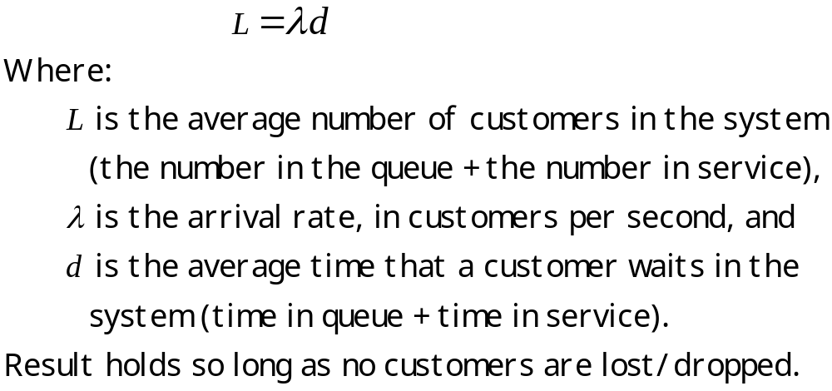
Little’s Result
Winter 2006
CS244a Handout 3

Slide 44
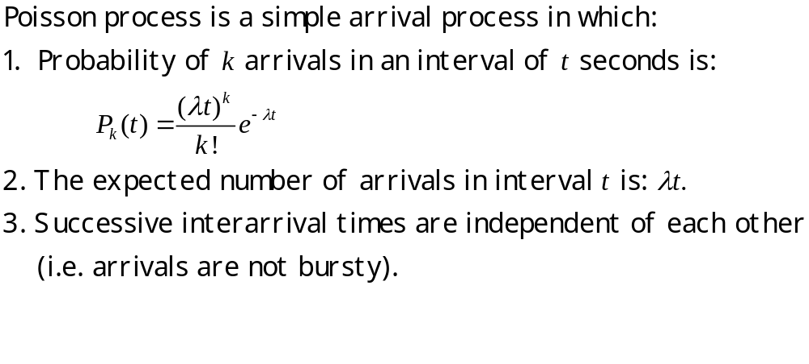
The Poisson process
Winter 2006
CS244a Handout 3

Slide 45
The Poisson process
Why use the Poisson process?
  It is the continuous time equivalent of a series of coin tosses.
  The Poisson process is known to model well systems in which a large number of independent events are aggregated together. e.g.
    Arrival of new phone calls to a telephone switch
    Decay of nuclear particles
    “Shot noise” in an electrical circuit
  It makes the math easy.
Be warned
  Network traffic is very bursty!
  Packet arrivals are not Poisson.
  But it models quite well the arrival of new flows.
Winter 2006
CS244a Handout 3

Slide 46
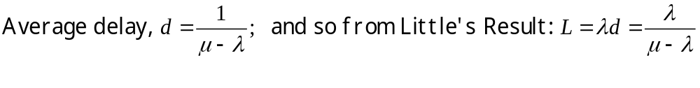
An M/M/1 queue
Model of FIFO router queue
A(t), λ
μ
D(t)
If A(t) is a Poisson process with rate λ, and the time to serve each packet is exponentially distributed with rate μ, then:
Winter 2006
CS244a Handout 3

